Slide 1
Intro to Lobe AI

Slide 2
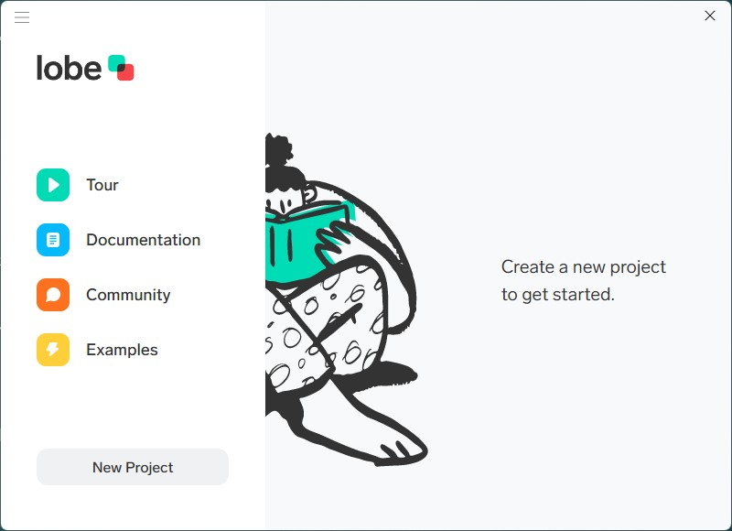
What is Lobe AI?
Lobe AI is a machine learning tool created by Microsoft
It allows a user to load images, label images, and train networks using images
After training, the network can be used locally in Lobe or exported for use in other applications, such as mobile apps on iPhone or Android
Lobe AI provides an easy way to develop a ML model without needing to know the coding

Slide 3
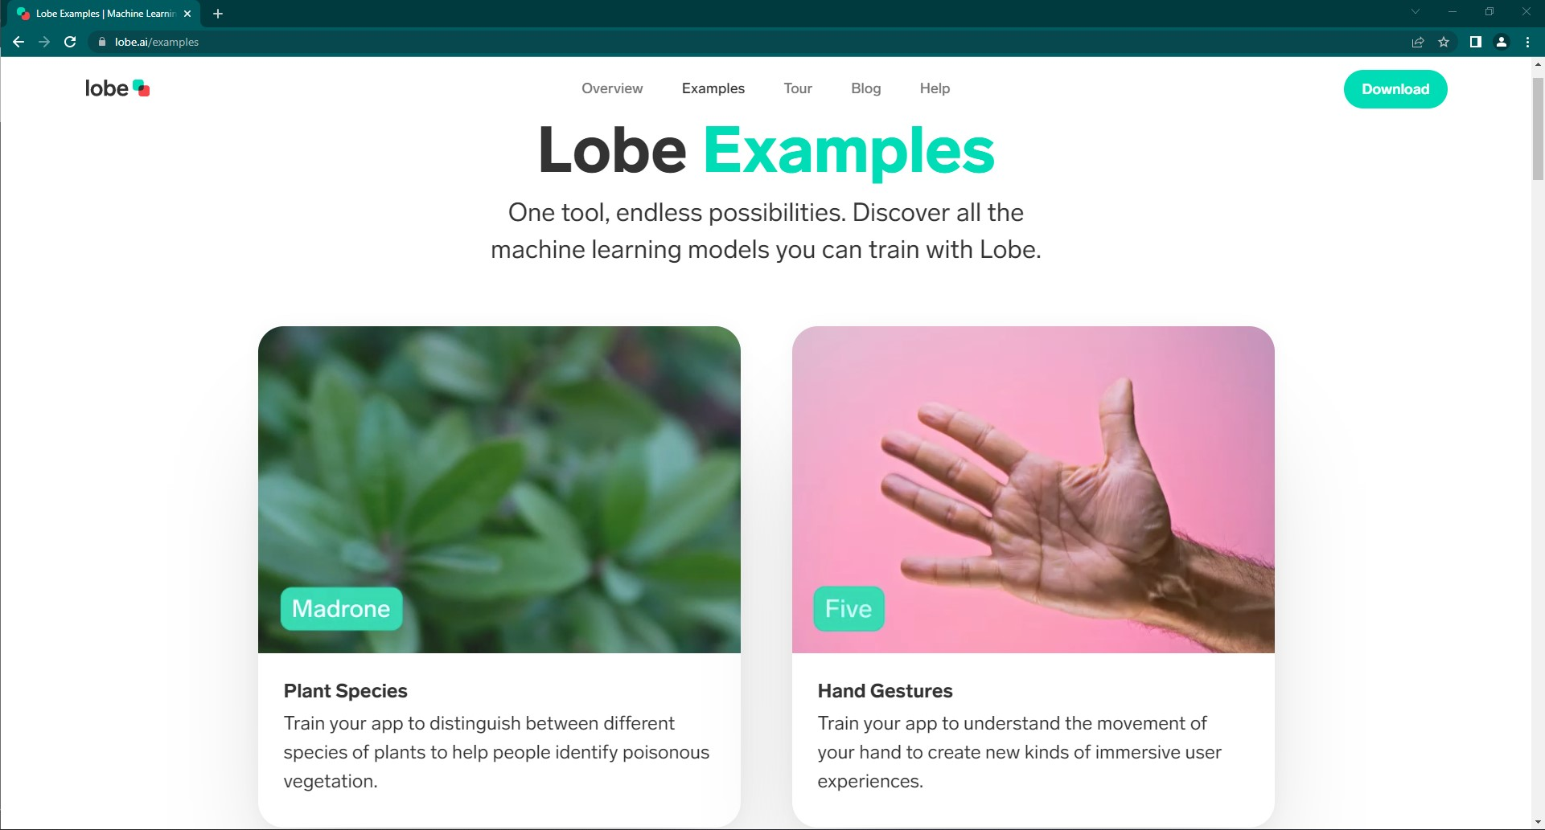
Using Lobe AI
In a web browser, navigate to the address below for examples of what Lobe AI is good at
https://www.lobe.ai/examples
What do you think of the examples?
Do you think a program like this is useful?

Slide 4
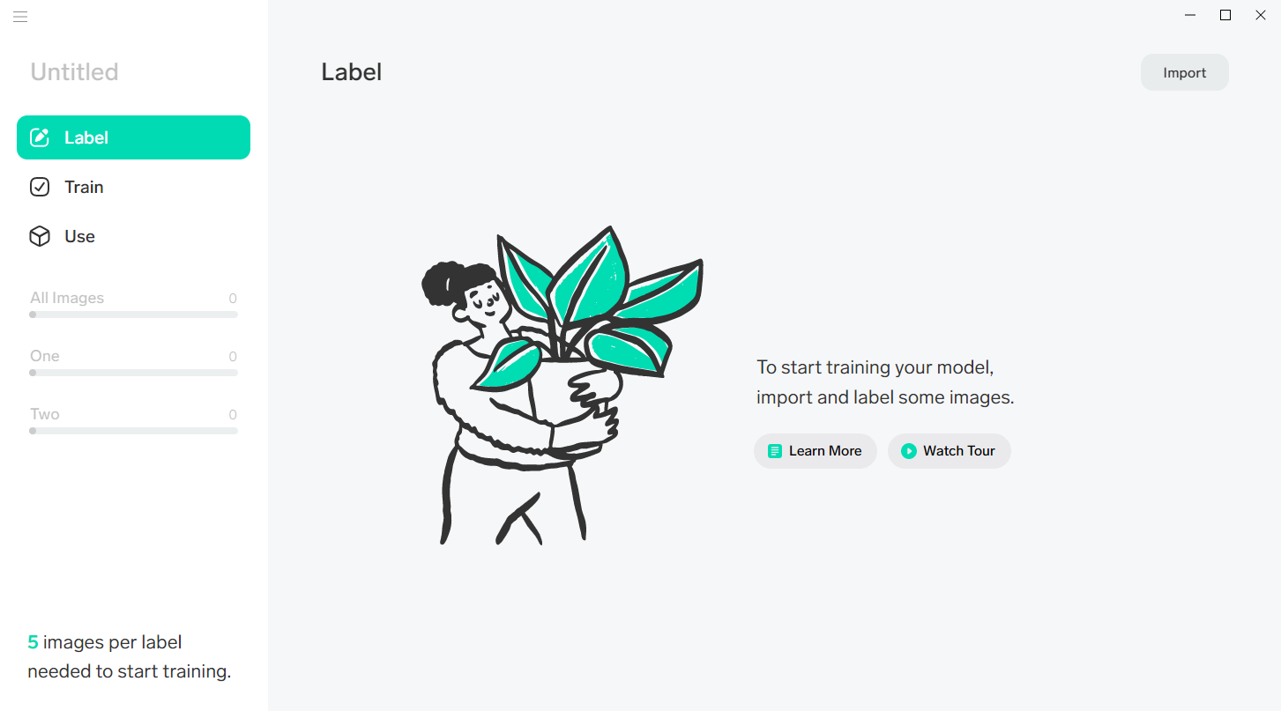
Creating a New ML Project
Option Button
Project Name
Import Button
Dataset Button
Training Button
Export Button
Classification Statistics

Slide 5
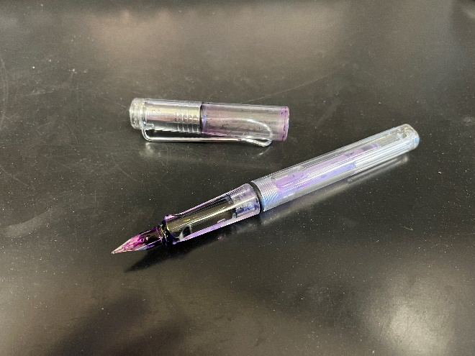
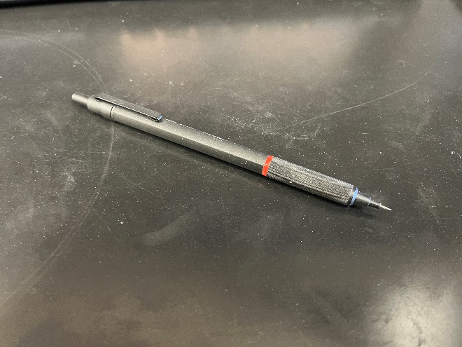
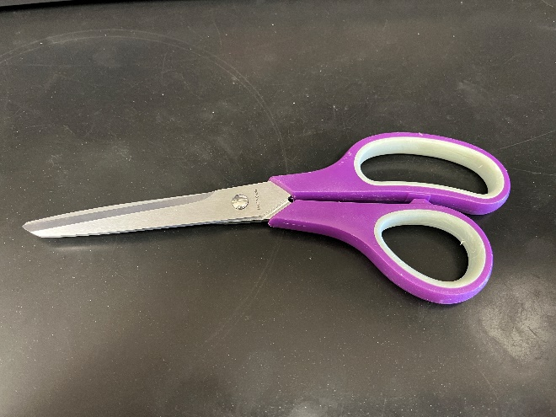


Creating a New Project
A functioning project should have a minimum of 5 images per label uploaded to the application
A “label” refers to the name of the object or thing, i.e., pen, pencil, scissors, person, book, etc.
Pen
Pencil
Scissors
Person
Book

Slide 6
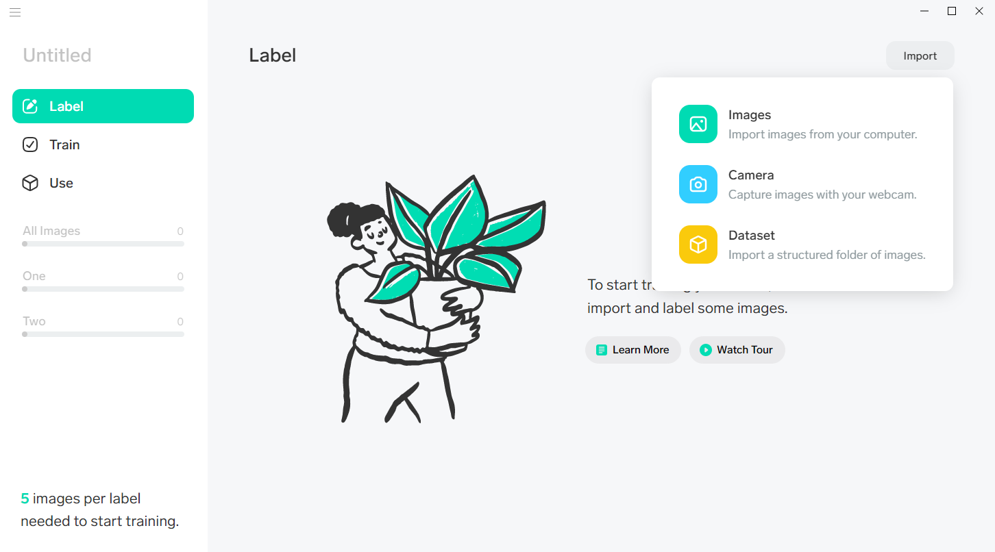
Example Project
To upload photos, or take pictures with the webcam, click on Import in the top right corner

Slide 7
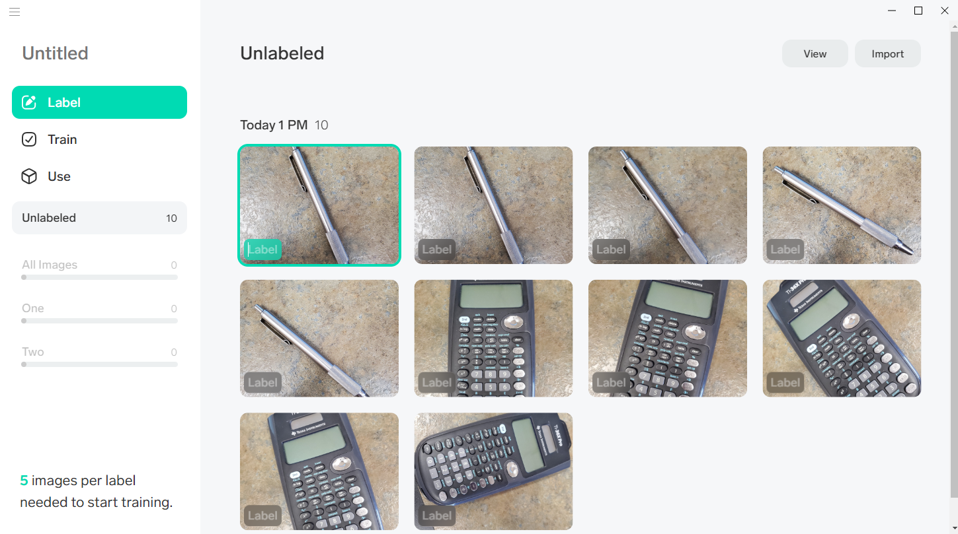
Example Project
For this example, the image below shows an unlabeled dataset of a calculator and a pen in the Lobe AI app

Slide 8
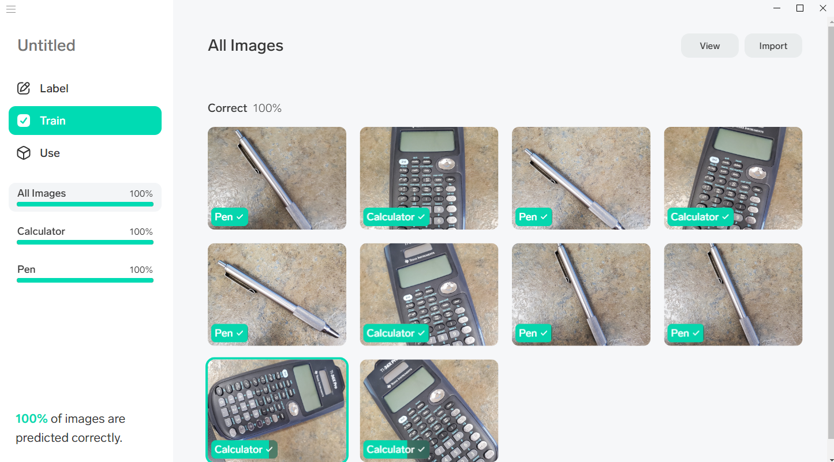
Example Project
To label the photos, click on a photo where it says “Label” and then use the keyboard to type the labels name into the box
After you have typed in the label, click on the next photo

Slide 9
Example Project
Once all the photos are labeled, training will automatically start
Click on the “Train” tab on the left to see the training progress

Slide 10
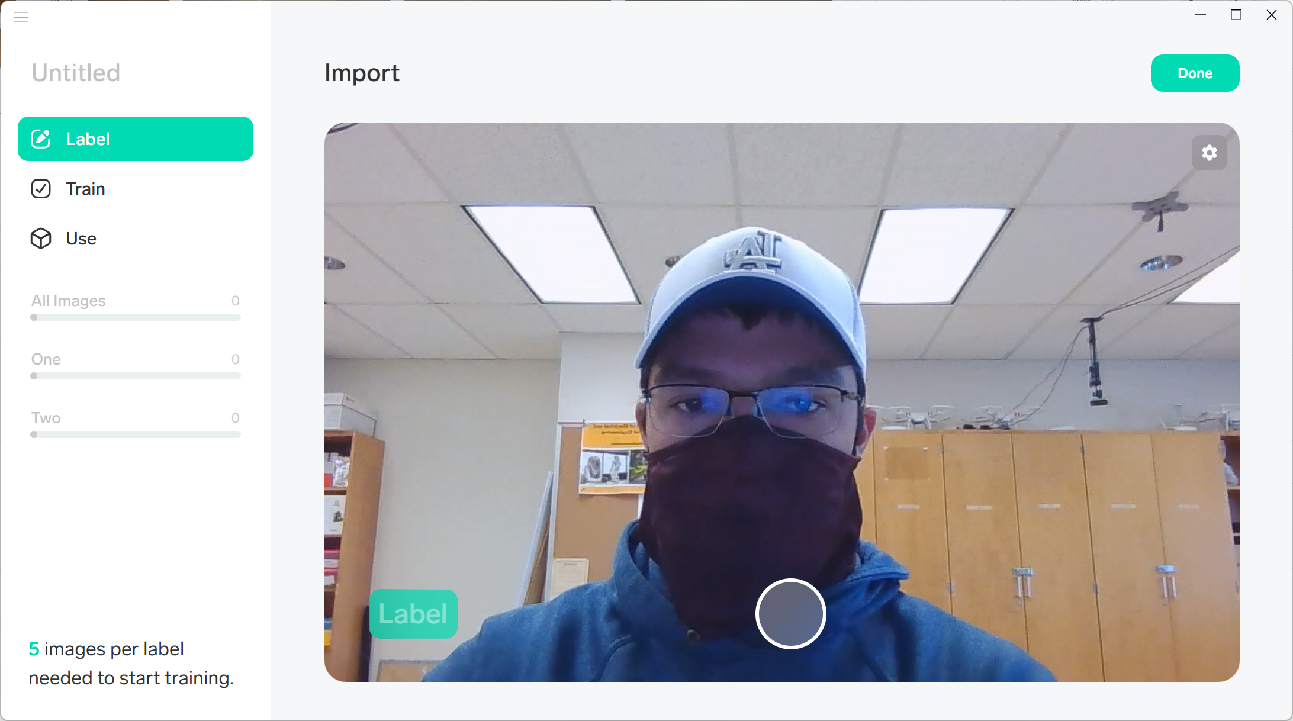
Example Project
Alternatively, you can label images as they are taken. When you are taking images with your camera, select the gray box in the bottom left of the window (green in the image below) and select or type the label for the images that will be collected.

Slide 11
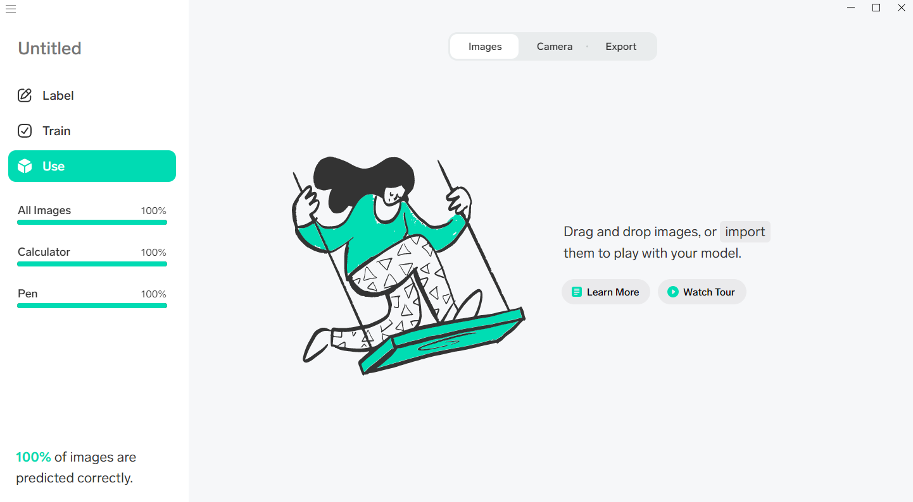
Example Project
After the training is finished, it is time to test the project
Click on the “Use” tab

Slide 12
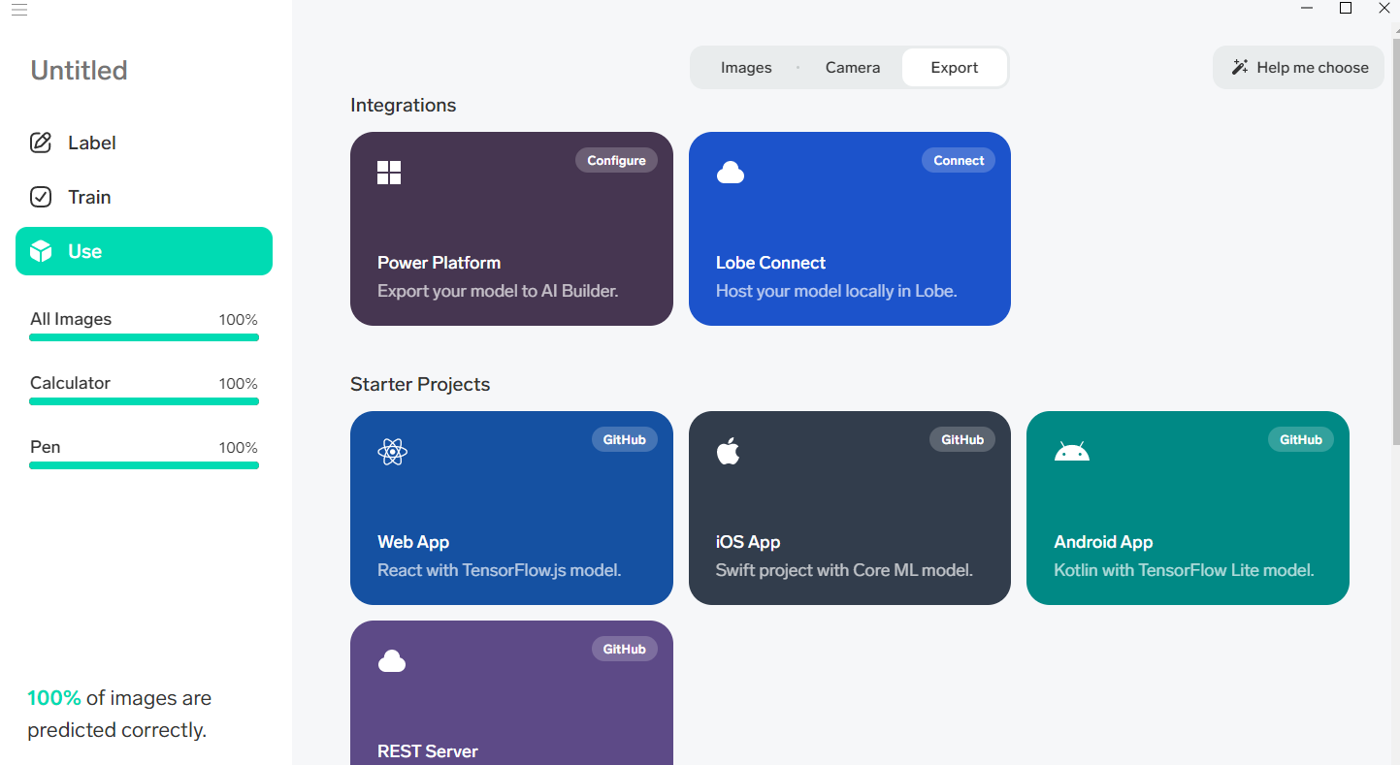
Example Project
If the model is to be used elsewhere it can be exported from the “Use” page under the “Export” tab

Slide 13
Up Next
Rock Paper Scissors

Slide 14
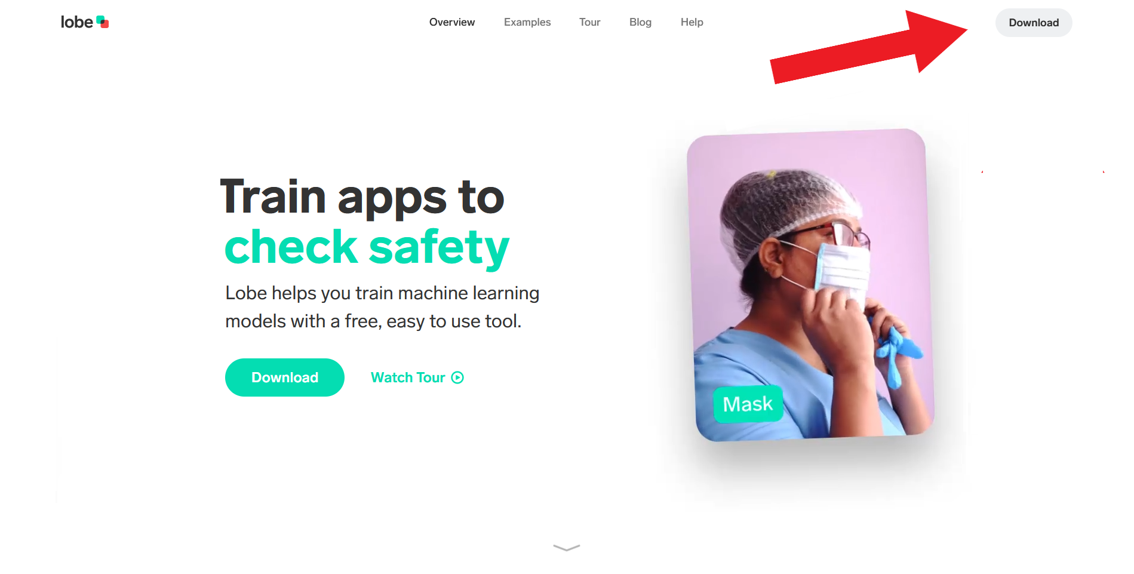
Setup
On the Lobe AI webpage, click the “Download” button in the top right
https://www.lobe.ai/

Slide 15
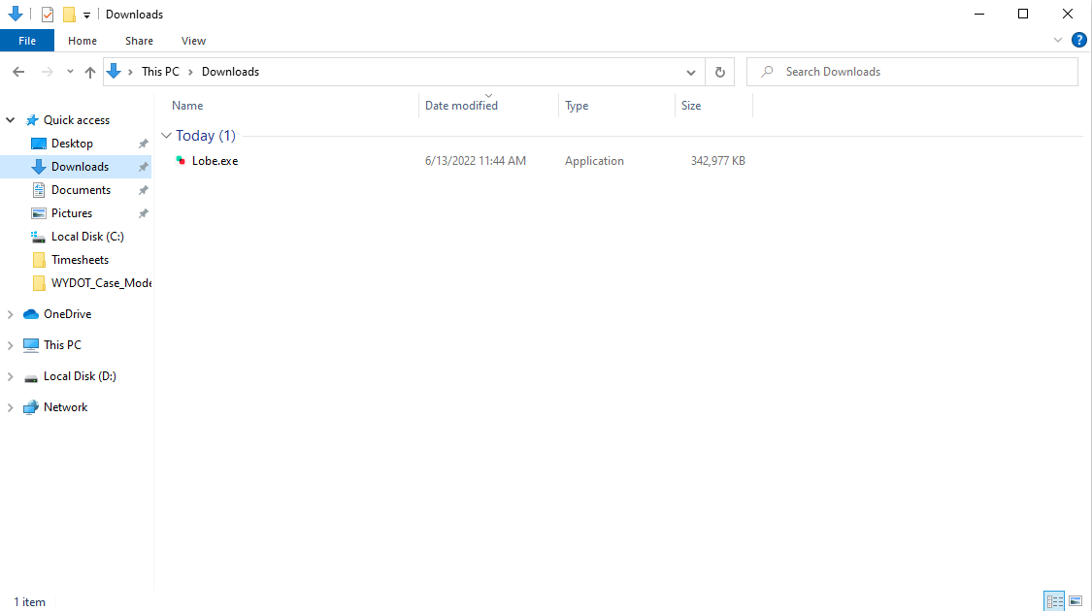

Download and Setup
Open File Explorer and navigate to the Downloads folder

Slide 16
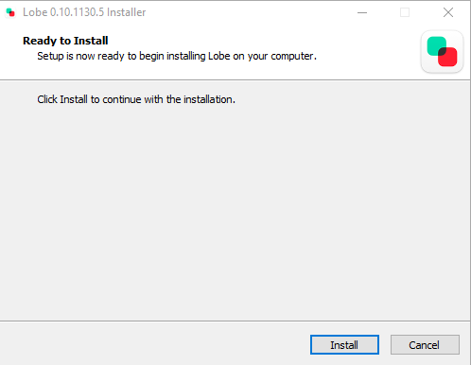
Download and Setup
Double-click on the Lobe.exe file
Click “Yes” on the pop-up
The Installer will say it's Ready to Install, click on the blue “Install” button

Slide 17
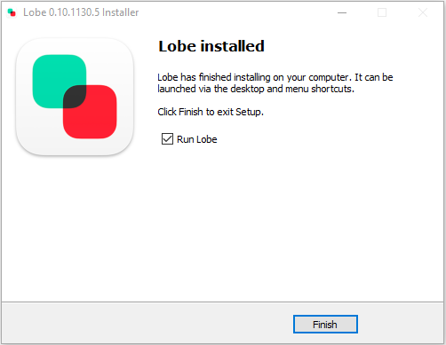
Download and Setup
Once the install is complete, click on “Finish”

Slide 18
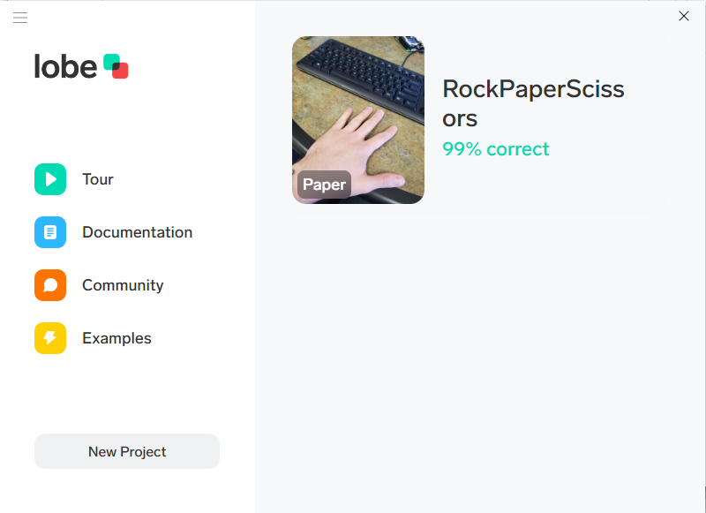
Creating a New Project
To start a new project, click the “New Project” button in the bottom left corner

